Slide 1

Face and Neck Injuries
CHAPTER 28

Slide 2
National EMS Education Standard Competencies (1 of 5)
Medicine
Applies fundamental knowledge to provide basic emergency care and transportation based on assessment findings for an acutely ill patient.
Notes:
National EMS Education Standard Competencies
Medicine
Applies fundamental knowledge to provide basic emergency care and transportation based on assessment findings for an acutely ill patient.

Slide 3
National EMS Education Standard Competencies (2 of 5)
Diseases of the Eyes, Ears, Nose, and Throat
  Recognition and management of
    Nosebleed
Notes:
National EMS Education Standard Competencies
Diseases of the Eyes, Ears, Nose, and Throat
Recognition and management of
• Nosebleed

Slide 4
National EMS Education Standard Competencies (3 of 5)
Trauma
Applies fundamental knowledge to provide basic emergency care and transportation based on assessment findings for an acutely injured patient.
Notes:
National EMS Education Standard Competencies
Trauma
Applies fundamental knowledge to provide basic emergency care and transportation based on assessment findings for an acutely injured patient.

Slide 5
National EMS Education Standard Competencies (4 of 5)
Head, Facial, Neck, and Spine Trauma
  Recognition and management of
    Life threats
  Pathophysiology, assessment, and management of
    Penetrating neck trauma
    Laryngotracheal injuries
Notes:
National EMS Education Standard Competencies
Head, Facial, Neck, and Spine Trauma
• Recognition and management of
Life threats
Spine trauma
• Pathophysiology, assessment, and management of
Penetrating neck trauma
Laryngotracheal injuries

Slide 6
National EMS Education Standard Competencies (5 of 5)
Head, Facial, Neck, and Spine Trauma (cont’d)
  Pathophysiology, assessment, and management of (cont’d)
    Facial fractures
    Foreign bodies in the eyes
    Dental trauma
Notes:
National EMS Education Standard Competencies
Spine trauma
Facial fractures
Skull fractures
Foreign bodies in the eyes
Dental trauma

Slide 7
Introduction
Face and neck are vulnerable to injury.
  Relatively unprotected positions on body
  Soft-tissue injuries and fractures are common and vary in severity.
Some injuries are life-threatening.
  Penetrating trauma to the neck may cause severe bleeding.
  Open injury may result in an air embolism.
Notes:
Lecture Outline
I. Introduction
A. The face and neck are particularly vulnerable to injury because of their relatively unprotected positions on the body.
1. Soft-tissue injuries and fractures are common and vary in severity.
2. Some injuries are life threatening.
a. Penetrating trauma to the neck may cause severe bleeding.
b. An open injury may allow an air embolism to enter the circulatory system.

Slide 8
The Head
Cranium
  Contains the brain
  Most posterior portion is called the occiput.
  Lateral portions on each side are called temples or temporal regions.
  Forehead is called the frontal region.
  Anterior to the ear, in the temporal region, you can feel the pulse of the superficial temporal artery.
Notes:
Lecture Outline
II. Anatomy and Physiology
A. The head is divided into the following:
1. Cranium
a. Also referred to as the skull
b. Contains the brain
c. The most posterior portion of the cranium is called the occiput.
d. On each side of the cranium, the lateral portions are called the temples or temporal regions.
e. The forehead is called the frontal region.
f. Anterior to the ear, in the temporal region, you can feel the pulse of the superficial temporal artery.

Slide 9
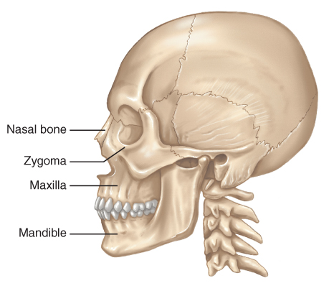
The Face (1 of 5)
Six major bones include:
  Nasal bone
  Two zygomas
  Two maxillae
  Mandible
FIGURE 28-1 The face is composed of six bones: the
nasal bone, two maxillae, two zygomas, and the mandible
© Jones & Bartlett Learning.
Notes:
Lecture Outline
b. The six major bones of the face include:
i. Nasal bone
ii. Two zygomas
iii. Two maxillae
iv. Mandible

Slide 10
The Face (2 of 5)
The orbit of the eye is composed of:
  Lower edge of the frontal bone of the skull
  Zygoma
  Maxilla
  Nasal bone
Protects the eye from injury
Notes:
Lecture Outline
The bony orbit protects the eye from injury.
i. Composed of the lower edge of the frontal bone, the zygoma, the maxilla, and the nasal bones.

Slide 11
The Face (3 of 5)
Only the proximal third of the nose is formed by bone.
  The remaining two thirds are composed of cartilage.
Notes:
Lecture Outline
b. Only the proximal third of the nose is formed by bone.

Slide 12
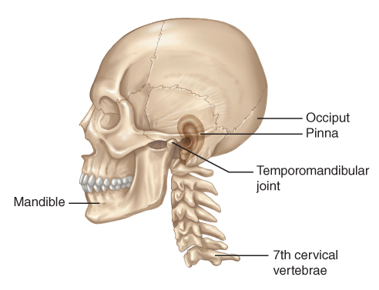
The Face (4 of 5)
The exposed portion of the ear is composed entirely of cartilage covered by skin.
  Pinna
  Tragus
  Superficial temporal artery
FIGURE 28-2 Specific landmarks of the head and neck
include the pinna, the mandible, the occiput, the seventh
cervical vertebra, and the temporomandibular joint.
© Jones & Bartlett Learning.
Notes:
Lecture Outline
d. The exposed portion of the ear is composed entirely of cartilage covered by skin.
i. The external, visible part is called the pinna.
ii. The tragus is a small, rounded, fleshy bulge immediately anterior to the ear canal.
iii. The superficial temporal artery can be palpated just anterior to the tragus.

Slide 13
The Face (5 of 5)
About 1 inch posterior to the external opening of the ear is the mastoid process.
The mandible forms the jaw and chin.
Notes:
Lecture Outline
e. About 1 inch posterior to the external opening of the ear is the mastoid process.
f. The mandible forms the jaw and chin.

Slide 14
The Neck (1 of 4)
Contains many important structures
Supported by the cervical spine
The upper part of the esophagus and the trachea lie in the midline of the neck.
The carotid arteries are found on either side of the trachea.
Notes:
Lecture Outline
B. Neck
1. Contains many important structures
2. Supported by the cervical spine
a. First seven vertebrae in the spinal column (C1 through C7)
b. The spinal cord exits from the foramen magnum and lies within the spinal canal formed by the vertebrae.
3. The upper part of the esophagus and the trachea lie in the midline of the neck.
a. The carotid arteries are found on either side of the trachea, along with the jugular veins and several nerves.

Slide 15
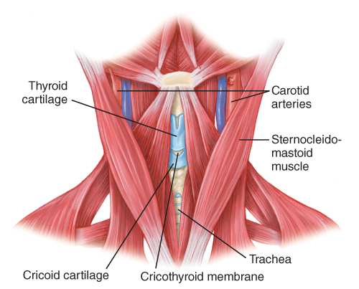
The Neck (2 of 4)
The larynx
  Adam’s apple is located in the center of the neck.
  Other portion of the larynx is the cricoid cartilage.
FIGURE 28-3 Important landmarks in the neck include the
cricoid cartilage, the thyroid cartilage, the carotid arteries,
the cricothyroid membrane, and the sternocleidomastoid
muscles.
© Jones & Bartlett Learning
Notes:
Lecture Outline
4. The larynx
a. The Adam’s apple is located in the center of the anterior of the neck.
b. The other portion of the larynx is the cricoid cartilage, a firm ridge of cartilage below the thyroid cartilage.

Slide 16
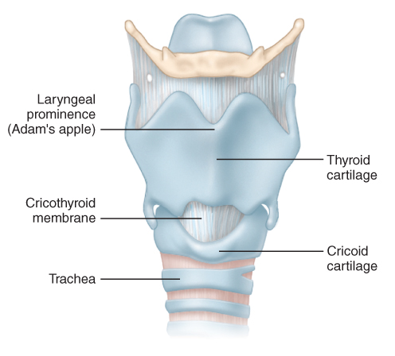
The Neck (3 of 4)
The larynx (cont’d)
  The cricothyroid membrane lies between the thyroid cartilage and the cricoid cartilage.
FIGURE 28-4 The larynx
© Jones & Bartlett Learning
Notes:
Lecture Outline
c. Cricothyroid membrane lies between the thyroid cartilage and the cricoid cartilage.

Slide 17
The Neck (4 of 4)
The trachea
  Below the larynx
  Connects the oropharynx and larynx with the main passages of the lungs
Sternocleidomastoid muscles
  Originate from the mastoid process
  Allow movement of the head
Notes:
Lecture Outline
5. The trachea
a. Below the larynx
b. The trachea connects the oropharynx and the larynx with the main passages of the lungs.
c. On either side of the lower larynx and the upper trachea lies the thyroid gland.
6. Sternocleidomastoid muscles
a. Originate from the mastoid process of the cranium and insert into the medial border of each collarbone and the sternum at the base of the neck
b. Allow movement of the head

Slide 18
The Eye (1 of 7)
Globe-shaped, approximately 1 inch in diameter
Located within a bony socket in the skull called the orbit
  Composed of adjacent bones of the face and skull
  Protects over 80% of the eyeball
Notes:
Lecture Outline
C. The eye
1. Globe-shaped, approximately 1 inch in diameter
2. Located within a bony socket in the skull called the orbit
a. Composed of adjacent bones of the face and skull.
b. In adults, the orbit protects over 80% of the eyeball.
c. Between and below the orbits are the nasal bone and the sinuses.

Slide 19
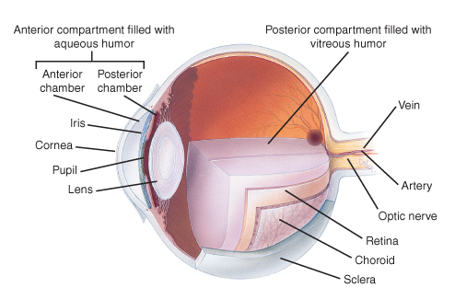
The Eye (2 of 7)
FIGURE 28-5 The major structures of the eye.
© Jones & Bartlett Learning
Notes:
The figure on this slide illustrates the major components of the eye.

Slide 20
The Eye (3 of 7)
Clear, jellylike fluid near the back of the eye is called vitreous humor.
In front of the lens is a fluid called the aqueous humor, which can leak out in penetrating injuries.
Notes:
Lecture Outline
3. The eyeball, or globe, keeps its shape as a result of pressure from the fluid contained within its two chambers.
a. Clear, jellylike fluid near the back of the eye is called the vitreous humor.
b. In front of the lens is a clear fluid called the aqueous humor.

Slide 21
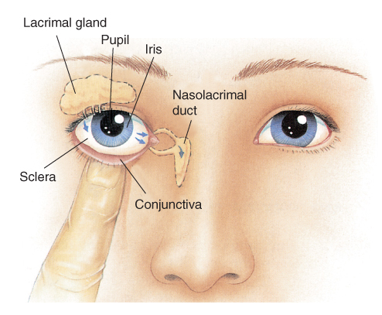
The Eye (4 of 7)
The conjunctiva is the membrane that covers the eye.
The lacrimal glands produce fluid to keep the eye moist.
FIGURE 28-6 The lacrimal system consists of tear glands and ducts. Tears act as a lubricant and keep the front of the eye from drying out.
© Jones & Bartlett Learning
Notes:
Lecture Outline
4. The conjunctiva is a membrane that covers the eye.
5. The lacrimal glands, often called tear glands, produce fluid to keep the eyes moist.
a. The tears drain on the inner side of the eye through two lacrimal ducts into the nasal cavity.

Slide 22
The Eye (5 of 7)
The sclera is the white, fibrous tissue that helps maintain the globular shape.
On the front of the eye, the sclera is replaced by a clear, transparent membrane called the cornea.
  Allows light to enter the eye
  The iris is a circular muscle behind the cornea.
Notes:
Lecture Outline
6. The sclera is the white, fibrous tissue that helps maintain the globular shape and protects the more delicate inner structures.
7. On the front of the eye, the sclera is replaced by a clear, transparent membrane called the cornea.
a. Allows light to enter the eye
b. The iris is a circular muscle behind the cornea.

Slide 23
The Eye (6 of 7)
The pupil is the opening in the center of the iris.
  Allows light to move to the back of the eye
  Anisocoria is a condition in which a person is born with different-sized pupils.
The lens lies behind the iris.
  Focuses images on the retina at the back of the globe
Notes:
Lecture Outline
8. The pupil is the opening in the center of the iris.
a. Allows light to move to the back of the eye
b. Anisocoria is a condition in which a person is born with different-sized pupils.
9. The lens lies behind the iris.
a. The lens focuses images on the retina at the back of the globe.

Slide 24
The Eye (7 of 7)
The retina contains nerve endings.
  Respond to light by transmitting nerve impulses through the optic nerve to the brain
  The retina is nourished by a layer of blood vessels called the choroid.
  Retinal detachment causes blindness.
Notes:
Lecture Outline
10. The retina contains nerve endings, which respond to light by transmitting nerve impulses through the optic nerve to the brain.
a. The retina is nourished by a layer of blood vessels between it and the back of the globe.
b. Retinal detachment is when the retina detaches from the underlying choroid and can cause blindness.

Slide 25
Injuries of the Face and Neck (1 of 2)
Can often lead to partial or complete obstruction of the upper airway
Several factors may contribute.
  Blood clots from heavy facial bleeding
  Direct injuries to the nose and mouth, larynx, and trachea
  Dislodgment of teeth or dentures into the throat
Notes:
Lecture Outline
III. Injuries of the Face and Neck
A. Injuries about the face and neck can often lead to partial or complete obstruction of the upper airway.
1. Several factors may contribute to the obstruction.
a. Blood clots in the upper airway from heavy facial bleeding
b. Direct injuries to the nose and mouth, the larynx, and the trachea are often the source of significant bleeding and/or respiratory compromise.
c. Injuries may cause teeth or dentures to become dislodged into the throat.

Slide 26
Injuries of the Face and Neck (2 of 2)
Several factors (cont’d)
  Swelling that accompanies direct and indirect injury
  Airway may be affected when the patient’s head is turned to the side
  Possible injuries to the brain and/or cervical spine
Notes:
Lecture Outline
d. Swelling that accompanies direct and indirect injury to the soft tissues can also contribute to airway obstruction.
e. The airway may also be affected when the patient’s head is turned to the side.
f. Possible injuries to the brain and/or cervical spine may interfere with normal respirations.

Slide 27
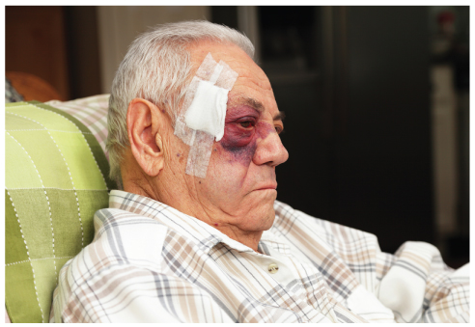
Soft-Tissue Injuries
Face and neck are extremely vascular.
  Swelling may be more severe.
  Skin and tissues in these areas have a rich blood supply.
  A blunt injury can cause a hematoma.
FIGURE 28-7 Facial hematoma.
© Willowpix/E+/Getty Images.
Notes:
Lecture Outline
B. Soft-tissue injuries
1. The face and neck are extremely vascular.
a. Swelling in this area may be more severe.
b. Skin and tissues in these areas have a rich blood supply.
c. A blunt injury can cause a hematoma.

Slide 28
Dental Injuries (1 of 2)
Mandible fractures are common.
Most injuries are the result of vehicle collisions and assaults.
Signs of mandible fractures include:
  Misalignment of the teeth
  Numbness of the chin
  An inability to open the mouth
Notes:
Lecture Outline
C. Dental injuries
1. Mandible injuries are common because of its prominence.
a. Second only to nasal fractures in frequency.
2. Most of these fractures are the result of vehicle collisions and assaults.
a. Signs of mandible fracture include:
i. Misalignment of the teeth
ii. Numbness of the chin
iii. An inability to open the mouth

Slide 29
Dental Injuries (2 of 2)
Maxillary fractures are usually found after blunt-force, high-energy impacts.
  Signs of maxillary fractures include:
    Massive facial swelling
    Instability of the facial bones
    Misalignment of teeth
Fractured and avulsed teeth are common following facial trauma.
Notes:
Lecture Outline
3. Maxillary fractures are usually found after blunt-force, high-energy impacts.
a. The signs of maxillary fractures include:
i. Facial swelling
ii. Instability of the facial bones
iii. Misalignment of teeth
4. Fractured and avulsed teeth are common following facial trauma.
a. Teeth fragments can become an airway obstruction and should be removed immediately.

Slide 30
Scene Size-up (1 of 2)
Scene safety
  Observe for hazards and threats.
  Assess for potential violence and environmental hazards.
  Eye protection and face mask are standard.
  Determine the number of patients.
Notes:
Lecture Outline
IV. Patient Assessment
A. Scene size-up
1. Scene safety
a. Assess for the potential of violence and environmental hazards.
b. Standard precautions require eye protection and a face mask, because of the potential for projectile blood.
c. Determine the number of patients and consider the need for additional assistance.

Slide 31
Scene Size-up (2 of 2)
Mechanism of injury/nature of illness
  Assess the scene.
  Common MOI for face and neck injuries:
    Motor vehicle collisions
    Sports
    Falls
    Penetrating trauma
    Blunt trauma
Notes:
Lecture Outline
2. Mechanism of injury
a. Assess the scene, looking for indicators of the mechanism of injury (MOI).
b. Common MOIs for face and neck injuries include:
i. Motor vehicle collisions
ii. Sports
iii. Falls
iv. Penetrating trauma
v. Blunt trauma

Slide 32
Primary Assessment (1 of 6)
Focuses on identifying and managing life-threatening concerns
Threats to XABCs must be treated immediately.
  When there is life-threatening external hemorrhage, it should be addressed before airway and breathing.
Notes:
Lecture Outline
B. Primary assessment
1. Focuses on identifying and managing life-threatening concerns
2. Threats to XABCs must be treated immediately.
a. When there is life-threatening external hemorrhage, it should be addressed before airway and breathing.

Slide 33
Primary Assessment (2 of 6)
Form a general impression.
  Look for important indicators about the seriousness of the patient’s condition.
  Injuries may be very obvious or hidden.
  Control blood loss with direct pressure.
  Consider the need for manual spinal stabilization.
  Check for responsiveness using the AVPU scale.
Notes:
Lecture Outline
3. Form a general impression.
a. Look for important indicators of the seriousness of the patient’s condition.
b. Injuries to the face and throat may be very obvious but may also be hidden by collars or hats.
c. Control blood loss with direct pressure.
d. Consider the need for manual spinal stabilization.
e. Check for responsiveness using the AVPU scale.

Slide 34
Primary Assessment (3 of 6)
Airway and breathing
  Ensure a clear and patent airway.
  If the patient is unresponsive or has significantly altered LOC, consider a properly sized oropharyngeal airway.
  Quickly assess for adequacy of breathing.
  Palpate the chest wall for DCAP-BTLS.
  Splinting or otherwise restricting chest wall motion is contraindicated.
Notes:
Lecture Outline
4. Airway and breathing
a. Ensure a clear and patent airway.
b. If the patient is unresponsive or has a significantly altered level of consciousness, consider a properly sized oropharyngeal airway.
c. Quickly assess for adequacy of breathing.
d. Splinting or otherwise restricting chest wall motion is contraindicated.

Slide 35
Primary Assessment (4 of 6)
Circulation
  Quickly assess pulse rate and quality.
  Determine skin condition, color, and temperature.
  Check capillary refill time.
  Significant bleeding is an immediate life threat.
Notes:
Lecture Outline
5. Circulation
a. Assess the pulse rate and quality.
b. Significant bleeding is an immediate life threat.

Slide 36
Primary Assessment (5 of 6)
Transport decision
  Consider quickly transporting patients with airway or breathing problems or with significant bleeding.
  Consider ALS backup.
  A patient with internal bleeding must be transported quickly for treatment by a physician.
Notes:
Lecture Outline
6. Transport decision
a. Consider quickly transporting patients with airway or breathing problems or with significant bleeding.
b. Stabilization and maintenance of an airway and breathing, as well as control of bleeding, can be very difficult in patients with facial or neck injuries.
c. Consider ALS backup if the transport time is long.
d. A patient with internal bleeding must be transported quickly for treatment by a physician.

Slide 37
Primary Assessment (6 of 6)
Transport decision (cont’d)
  Signs of hypoperfusion imply the need for rapid transport.
  The patient who has a significant MOI but whose condition appears stable should be transported promptly.
  Any significant blow to the face or throat should increase your suspicion of spinal or brain injury.
Notes:
Lecture Outline
e. Signs of hypoperfusion imply the need for rapid transport.
f. The patient who has a significant MOI but whose condition appears stable should also be transported promptly.
g. Remember that any significant blow to the face or throat should increase your suspicion of spinal or brain injury.
h. Even if the patient has no signs of hypoperfusion or other life-threatening injuries, there is the possibility of eye injuries.

Slide 38
History Taking
Investigate the chief complaint.
  Obtain a medical history.
  Be alert for injury-specific signs and symptoms.
  Be aware of pertinent negatives.
  Gather a SAMPLE history from the patient, or from friends and family.
Notes:
Lecture Outline
C. History taking
1. Investigate the chief complaint.
a. Obtain a medical history.
b. Be alert for injury-specific signs and symptoms.
c. Be aware of any pertinent negatives such as no pain or no loss of sensation.
2. SAMPLE history
a. Attempt to gather from friends or family if the patient is unresponsive
b. In unresponsive patients, you will only be able to notice signs of injuries.

Slide 39
Secondary Assessment (1 of 4)
Physical examinations
  If multiple systems have been affected, start with an assessment of the entire body, looking for DCAP-BTLS.
  Do not delay transport to complete a thorough physical examination.
  In a responsive patient with an isolated injury with limited MOI, consider focusing on the isolated injury, the patient’s chief complaint, and the body region affected.
Notes:
Lecture Outline
D. Secondary assessment
1. Physical examinations
a. If multiple systems are likely to have been affected, start with an assessment of the entire body looking for DCAP-BTLS.
b. Do not delay transport to complete a thorough physical examination.
c. In a responsive patient who has an isolated injury with a limited MOI, consider focusing your physical examination.

Slide 40
Secondary Assessment (2 of 4)
Physical examinations (cont’d)
  Ensure that control of bleeding is maintained and note injury location.
  Inspect the open wound for any foreign matter and stabilize impaled objects.
  Use both your eyes and your hands.
  Assess all underlying systems.
Notes:
Lecture Outline
d. Ensure that control of bleeding is maintained and note the location of the injury.
e. Inspect the open wound for any foreign matter and stabilize impaled objects.
f. During the physical examination, use both your eyes and your hands.
g. If your patient is responsive, you should explain exactly what you are doing and what you are looking for.
h. Assess all underlying systems.

Slide 41
Secondary Assessment (3 of 4)
Physical examinations (cont’d)
  When evaluating the eyes, start with the outer aspect and work toward the pupils.
  Examine the eye for any obvious foreign matter.
  Visual acuity is a vital sign of the eye.
  Look for discoloration, bleeding, redness, eye symmetry, and pupil size and reaction to light.
Notes:
Lecture Outline
i. When evaluating the eyes, start with the outer aspect and work toward the pupils.
i. Visual acuity is considered the vital sign of the eye.

Slide 42
Secondary Assessment (4 of 4)
Vital signs
  Assess vital signs to obtain a baseline.
  You must be concerned with visible bleeding and unseen bleeding inside a body cavity.
  With facial and throat injuries, baseline information is very important.
  Use appropriate monitoring devices.
Notes:
Lecture Outline
2. Vital signs
a. Assess vital signs to obtain a baseline so that you can observe any changes during treatment.
b. You must be concerned with visible bleeding and unseen bleeding inside a body cavity.
c. With facial and throat injuries, baseline information about respirations and pulse is very important.
d. Use monitoring devices

Slide 43
Reassessment (1 of 3)
Repeat the primary assessment.
Reassess vital signs and the chief complaint.
  Reassess the patient’s condition at least every 5 minutes.
Interventions
  Provide complete spinal immobilization if necessary.
Notes:
Lecture Outline
E. Reassessment
1. Repeat the primary assessment.
2. Reassess vital signs and the chief complaint.
a. Continually reassess the adequacy of airway, breathing, and circulation.
3. Recheck patient interventions.
a. This is particularly important in patients with facial or neck injuries because the ease in which injuries can affect associated systems.
b. The patient’s condition should be reassessed at least every 5 minutes.
4. Interventions
a. Provide complete spinal immobilization to any patient with suspected spinal injuries.

Slide 44
Reassessment (2 of 3)
Interventions (cont’d)
  Maintain an open airway, be prepared to suction, and consider an oropharyngeal airway.
  Whenever you suspect significant bleeding, provide high-flow oxygen.
  Control significant visible bleeding.
Notes:
Lecture Outline
b. Maintain an open airway, be prepared to suction the patient, and consider an oropharyngeal airway.
c. Whenever you suspect significant bleeding, provide high-flow oxygen.
d. Control any significant visible bleeding.

Slide 45
Reassessment (3 of 3)
Interventions (cont’d)
  If the patient has signs of hypoperfusion, treat aggressively for shock and provide rapid transport.
Communication and documentation
  Include a description of the MOI and the position in which you found the patient.
Notes:
Lecture Outline
e. If the patient has signs of hypoperfusion, treat the patient aggressively for shock and provide rapid transport.
f. Do not delay transport of a seriously injured patient to complete nonlifesaving treatments in the field.
5. Communication and documentation
a. In your documentation, include a description of the MOI and the position in which you found the patient.

Slide 46
Emergency Medical Care (1 of 5)
Treat soft-tissue injuries to the face and neck the same as soft-tissue injuries elsewhere on the body.
  Assess XABCs and life threats first.
  Follow standard precautions.
  In the absence of life-threatening bleeding, first open and clear the airway.
  Avoid moving the neck in patients with suspected cervical spine injuries.
Notes:
Lecture Outline
V. Emergency Medical Care
A. Treat soft-tissue injuries to the face and neck the same as soft-tissue injuries elsewhere on the body.
1. Assess XABCs and life threats first.
a. Follow standard precautions.
b. In the absence of life-threatening bleeding, the first step is to open and clear the airway.
c. Avoid moving the neck in patients with suspected cervical spine injuries.

Slide 47
Emergency Medical Care (2 of 5)
Control bleeding by applying direct manual pressure with a dry, sterile dressing.
  Use roller gauze, wrapped around the head, to hold a pressure dressing in place.
  Do not apply excessive pressure if an underlying skull fracture is suspected.
Notes:
Lecture Outline
B. Control bleeding by applying direct manual pressure with a dry, sterile dressing.
1. Use roller gauze, wrapped around the circumference of the head, to hold a pressure dressing in place.
2. Do not apply excessive pressure if there is a possibility of an underlying skull fracture.

Slide 48
Emergency Medical Care (3 of 5)
Cover exposed brain, eye, or other structures with a moist, sterile dressing.
Apply ice locally to injuries that do not break the skin.
For soft-tissue injuries around the mouth, check for bleeding inside the mouth.
Notes:
Lecture Outline
3. When an injury exposes the brain, eye, or other structures, cover the exposed parts with a moist, sterile dressing.
4. Apply ice locally to injuries that do not break the skin.
5. For soft-tissue injuries around the mouth, check for bleeding inside the mouth.

Slide 49
Emergency Medical Care (4 of 5)
Physicians can sometimes graft a piece of avulsed skin back into position.
  If you find portions of avulsed skin:
    Wrap in a sterile dressing.
    Place in a plastic bag.
    Keep cool, but do not place directly on ice.
    Label and deliver to the emergency department.
Notes:
Lecture Outline
6. Physicians can sometimes graft a piece of avulsed skin back into the appropriate position.
a. If you find portions of avulsed skin, wrap them in a sterile dressing, place them in a plastic bag, and keep them cool.

Slide 50
Emergency Medical Care (5 of 5)
If the avulsed skin is still attached in a loose flap:
  Place the flap in position as close to normal as possible.
  Hold in place with a dry, sterile dressing.
Notes:
Lecture Outline
b. If the skin is still attached in a loose flap, place the flap in a position that is as close to normal as possible.

Slide 51
Injuries of the Eyes (1 of 18)
Eye injuries are common, particularly in sports.
  Can produce lifelong complications, including blindness
After an injury, pupil reaction or shape and eye movement are disturbed.
Notes:
Lecture Outline
VI. Emergency Medical Care for Specific Injuries
A. Injuries of the eyes
1. Eye injuries are common, particularly in sports.
a. Can produce lifelong complications, including blindness
b. Proper emergency treatment will minimize pain and may prevent a permanent loss of vision.
2. After an injury, pupil reaction or shape and eye movement are often disturbed.
a. Abnormal pupil reactions sometimes are a sign of brain injury rather than an eye injury.

Slide 52
Injuries of the Eyes (2 of 18)
Treatment starts with a thorough examination.
  Always use standard precautions.
  Take care not to aggravate any problems.
  Look for abnormalities or conditions that may suggest the nature of the injury.
Notes:
Lecture Outline
3. Treatment starts with a thorough examination.
4. Look for specific abnormalities or conditions that may suggest the nature of the injury.

Slide 53
Injuries of the Eyes (3 of 18)
Foreign objects
  The orbit protects the eye from the penetration of large objects.
  Even a small object may produce severe irritation.
  Irrigation with a sterile saline solution will frequently flush away loose particles.
Notes:
Lecture Outline
5. Foreign objects
a. The orbit protects the eye from the penetration of large objects.
b. Even a very small object may produce severe irritation.
c. Irrigation with a sterile saline solution will frequently flush away loose, small particles.

Slide 54
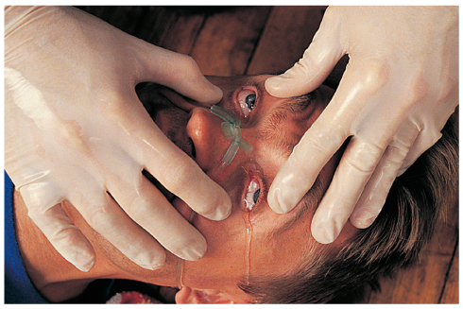
Injuries of the Eyes (4 of 18)
Foreign objects (cont’d)
  Always flush from the nose side of the eye toward the outside to avoid flushing material into the other eye.
© American Academy of Orthopaedic Surgeons
Notes:
Lecture Outline
e. Gentle irrigation usually will not wash out foreign bodies stuck to the cornea or lying under the upper eyelid. If you spot a foreign object on the surface of the eyelid, you may be able to remove it with a moist, sterile, cotton-tipped applicator. Follow the steps in Skill Drill 28-1.

Slide 55
Injuries of the Eyes (5 of 18)
Foreign objects (cont’d)
  A foreign body will leave a small abrasion on the conjunctiva.
  Gentle irrigation may not wash out foreign bodies stuck to the cornea or lying under the upper eyelid.
Notes:
Lecture Outline
d. A foreign body will leave a small abrasion on the conjunctiva.
e. Gentle irrigation usually will not wash out foreign bodies stuck to the cornea or lying under the upper eyelid. If you spot a foreign object on the surface of the eyelid, you may be able to remove it with a moist, sterile, cotton-tipped applicator. Follow the steps in Skill Drill 28-1.

Slide 56
Injuries of the Eyes (6 of 18)
Foreign objects (cont’d)
  Foreign bodies may be impaled in the eye.
  Bandage the object in place to support it.
  Cover the eye with a moist, sterile dressing.
  Surround the object with a doughnut-shaped collar.
  When you see or suspect an impaled object(s) in the eye, bandage both eyes with soft, bulky dressings to prevent further injury.
Notes:
Lecture Outline
Foreign bodies may be impaled in the eye.
i. Must be removed by a physician
g. Your care involves stabilizing the object and preparing the patient for transport. Follow the steps in Skill Drill 28-2.
h. When you see or suspect an impaled object(s) in the eye, bandage both eyes with soft, bulky dressings to prevent further injury.

Slide 57
Injuries of the Eyes (7 of 18)
Burns of the eye
  Stop the burn and prevent further damage.
Chemical burns
  Usually caused by acid or alkaline solutions
  Flush the eye with water or saline.
  Direct the greatest amount of irrigating solution or water into the eye as gently as possible.
Notes:
Lecture Outline
6. Burns of the eye
a. Stop the burn and prevent further damage.
b. Chemical burns
i. Usually caused by acid or alkaline solutions
ii. Flush the eye with water or sterile saline irrigation solution.
iii. Direct the greatest amount of irrigating solution or water into the eye as gently as possible.

Slide 58
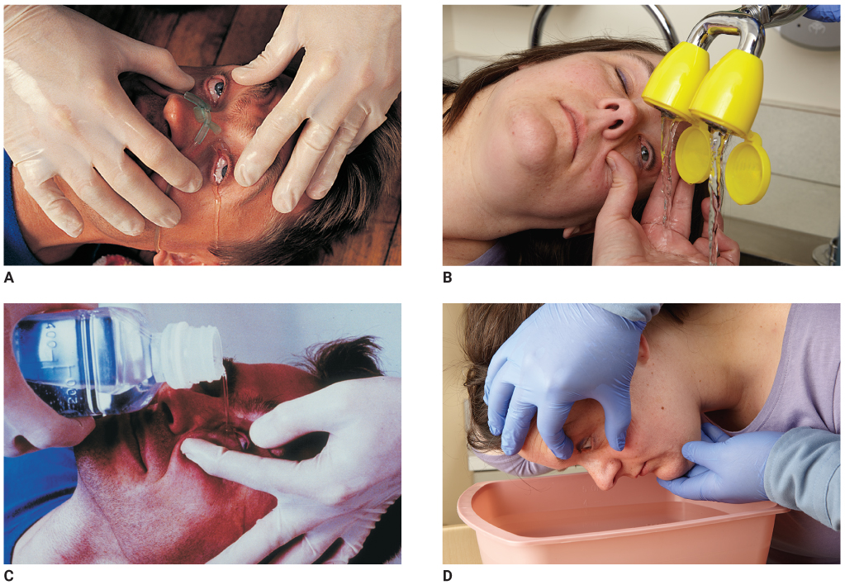
Injuries of the Eyes (8 of 18)
FIGURE 28-17 The following are four ways to effectively irrigate the eye. A. Nasal cannula. B. Shower. C. Bottle. D. Basin.
Remember, you must protect the uninjured eye from the irrigating solution to prevent exposure of the unaffected eye to the substance.
A, C: © American Academy of Orthopaedic Surgeons; B, D: © Jones & Bartlett Learning.
Notes:
The figures on this slide demonstrate four ways to irrigate the eye. A. Nasal cannula. B. Shower. C. Bottle. D. Basin.

Slide 59
Injuries of the Eyes (9 of 18)
Chemical burns (cont’d)
  You may have to force the lids open.
  Flush from the inner to outside corner.
  If the burn was caused by an alkali or a strong acid, irrigate continuously for at least 20 minutes.
  After irrigation, apply a clean, dry dressing to cover the eye and transport.
Notes:
Lecture Outline

Slide 60
Injuries of the Eyes (10 of 18)
Thermal burns
  During a fire, the eyes will close to protect from heat, and the eyelids will burn.
  Transport promptly without further examination.
  Cover both eyes with a sterile dressing moistened with sterile saline.
  Apply eye shields over the dressing.
Notes:
Lecture Outline
Thermal burns
i. During a fire, the eyes will close to protect from heat.
ii. Eyelids are frequently burned and require specialized care.
iii. Cover both eyes with a sterile dressing moistened with sterile saline

Slide 61
Injuries of the Eyes (11 of 18)
Light burns
  Infrared rays, eclipse light, and laser beams all can cause significant damage.
  Retinal injuries caused by exposure to light are generally not painful but may result in permanent damage.
  Severe conjunctivitis usually develops with redness, swelling, and excessive tears.
Notes:
Lecture Outline
d. Light burns
i. Infrared rays, eclipse light, and laser beams all can cause significant damage to the sensory cells of the eye.
ii. Retinal injuries caused by exposure to extremely bright light are generally not painful but may result in permanent damage.
iii. Superficial burns of the eye can result from ultraviolet rays from an arc welding unit; light from prolonged exposure to a sunlamp; or reflected light from a bright, snow-covered area.
iv. May not be painful at first, but may become so 3 to 5 hours later
v. Severe conjunctivitis usually develops, with redness, swelling, and excessive tear production.
vi. Cover each eye with a sterile, moist pad and an eye shield.

Slide 62
Injuries of the Eyes (12 of 18)
Lacerations
  Require very careful repair to restore appearance and function
  Bleeding may be heavy, but it usually can be controlled with gentle, manual pressure.
  If there is a laceration of the globe itself, apply no pressure to the eye.
Notes:
Lecture Outline
7. Lacerations
a. Require very careful repair to restore appearance and function.
b. If there is a laceration of the globe itself, apply no pressure to the eye.
i. Gently apply a moist, sterile dressing to prevent drying.
ii. Cover the injured with a protective metal eye shield, cup, or sterile dressing to prevent drying.
iii. Apply a soft dressing to both eyes.

Slide 63
Injuries of the Eyes (13 of 18)
Lacerations (cont’d)
  On rare occasions, the eyeball may be displaced from its socket.
  Do not attempt to reposition it.
  Cover the eye and stabilize it with a moist sterile dressing.
  Cover both eyes to prevent further injury.
  Have the patient lie supine.
Notes:
Lecture Outline
c. On rare occasions, the eyeball may be displaced from its socket.
i. Do not attempt to reposition it.
ii. Cover the eye and stabilize it with a moist sterile dressing.
iii. Cover both eyes to prevent further injury because of sympathetic movement.
iv. Have the patient lie supine to prevent loss of fluid from the eye.

Slide 64
Injuries of the Eyes (14 of 18)
Blunt trauma
  Hyphema obscures all or part of the iris.
  An orbit fracture is a fracture of the bones that form the eye floor and support the globe.
  Retinal detachment is often seen in sports.
Notes:
Lecture Outline
8. Blunt trauma
a. Hyphema (bleeding into the anterior chamber of the eye) obscures all or part of the iris.
b. Orbit fracture (blow-out fracture)
i. Bone fragments can entrap some of the muscles that control eye movement, causing double vision.
ii. Protect the injured eye with a metal shield and cover the other eye to minimize movement on the other injured side.
c. Retinal detachment
i. Often seen in sports, especially boxing

Slide 65
Injuries of the Eyes (15 of 18)
Eye injuries following head injury
  Signs and symptoms of a possible head injury:
    One pupil larger than the other
    Eyes not moving together
    Failure of the eyes to follow your finger
    Bleeding under the conjunctiva
    Protrusion or bulging of one eye
Notes:
Lecture Outline
9. Eye injuries following head injury
a. Signs and symptoms of a possible head injury
i. One pupil larger than the other
ii. Eyes not moving together or pointing in different directions
iii. Failure of the eyes to follow movement of your finger as instructed
iv. Bleeding under the conjunctiva
v. Protrusion or bulging of one eye
b. Management
i. Keep the eyelids closed
ii. Cover the lids with moist gauze or hold them closed with clear tape.

Slide 66
Injuries of the Eyes (16 of 18)
Blast injuries
  Signs and symptoms range from severe pain and loss of vision to foreign bodies within the globe.
  If there is a foreign body within the globe, do not remove it.
  If only one eye is injured, follow local protocol.
  If the patient has severe swelling, do not force the eyelid open to examine it.
Notes:
Lecture Outline
10. Blast injuries
a. Signs and symptoms of blast injuries range from severe pain and loss of vision to foreign bodies within the globe.
b. Management of injuries to the eye depends on the severity of the injury.

Slide 67
Injuries of the Eyes (17 of 18)
Contact lenses and artificial eyes
  Do not attempt to remove contact lenses unless there is a chemical burn.
  To remove a hard contact lens, use a small suction cup.
  To remove soft contact lenses, place one or two drops of saline in the eye, pinch the lens between your thumb and index finger, and lift.
Notes:
Lecture Outline
11. Contact lenses and artificial eyes
a. In general, do not attempt to remove contact lenses, except for chemical burns.
b. To remove a hard contact lens, use a small suction cup, moistening the end with saline.
c. To remove soft contact lenses, place one or two drops of saline in the eye, gently pinch the lens between your gloved thumb and index finger and lift it off the surface of the eye.
d. Place the lens in a container with sterile saline solution.
e. Advise the hospital staff if the patient is wearing contact lenses.
f. Care for an artificial eye as you would a normal one.

Slide 68
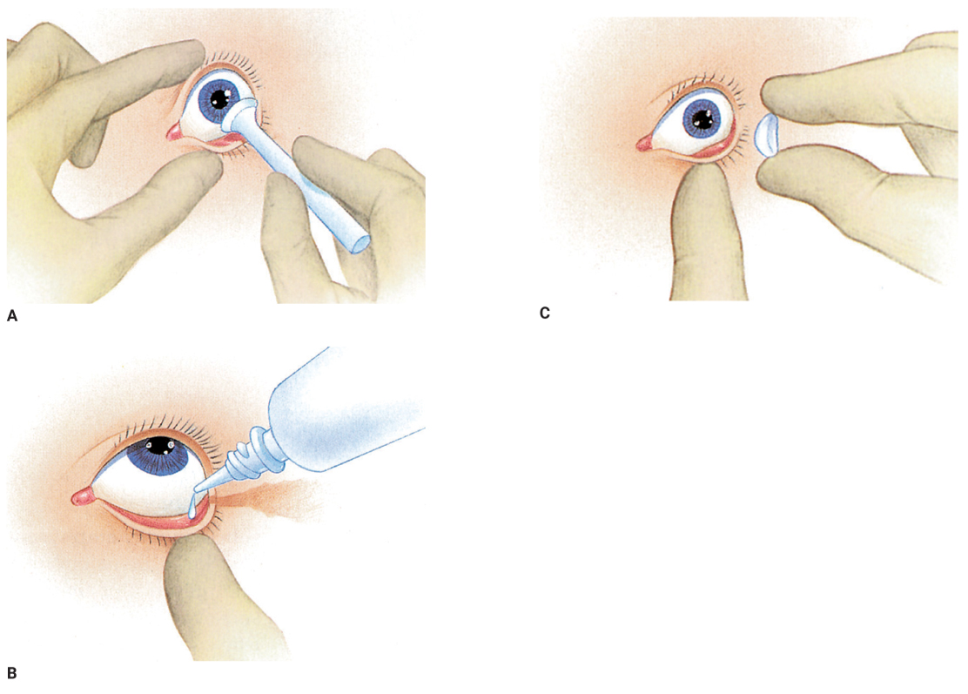
Injuries of the Eyes (18 of 18)
FIGURE 28-26 Removing contact lenses should be
limited to patients with chemical burn injuries to the eye.
A. To remove hard contact lenses, use a specialized
suction cup moistened with sterile saline solution. B. To
remove soft contact lenses, instill one or two drops of
saline or irrigating solution. C. Next, pinch off the lens with
your gloved thumb and index finger
A, B, C: © Jones & Bartlett Learning.
Notes:
The figures on this slide show how to remove hard contact lens and soft contact lens.

Slide 69
Injuries of the Nose (1 of 4)
Nosebleeds (epistaxis) are a common problem.
  One of the most common causes is digital trauma.
  Anterior nosebleeds usually originate from the area of the septum and bleed slowly.
  Posterior nosebleeds are usually more severe and often cause blood to drain into the throat.
Notes:
Lecture Outline
B. Injuries of the nose
1. Nosebleeds (epistaxis) are a common problem.
a. One of the most common causes is digital trauma.
b. Categorized into anterior and posterior epistaxis.
c. Anterior nosebleeds usually originate from the area of the septum and bleed fairly slowly.
d. Posterior nosebleeds are usually more severe and often cause blood to drain into the patient’s throat.

Slide 70
Injuries of the Nose (2 of 4)
Blunt injuries to the nose may be associated with fractures and soft-tissue injuries of the face, head injuries, and/or injuries to the cervical spine.
Notes:
Lecture Outline
2. Blunt injuries to the nose may be associated with fractures and soft-tissue injuries of the face, head injuries, and/or injuries to the cervical spine.

Slide 71
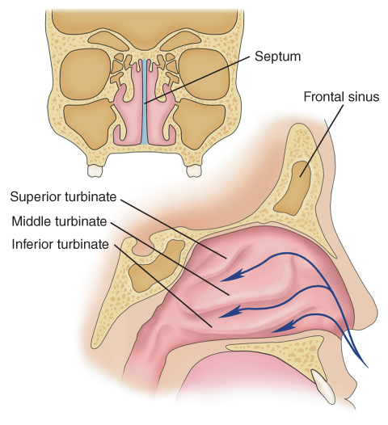
Injuries of the Nose (3 of 4)
Assess the nose structures for injury.
FIGURE 28-27 The nose has two chambers, divided by
the septum. Each chamber is composed of layers of bone
called turbinates. Above the nose are the frontal sinuses
and, on either side, the orbits of the eyes.
© Jones & Bartlett Learning.
Notes:
Lecture Outline
3. Assess the nose structures for injury.

Slide 72
Injuries of the Nose (4 of 4)
Patients with severe nasal injury may also have cervical spine injury.
Cerebrospinal fluid (CSF) may escape down through the nose following a fracture at the base of the skull.
Control bleeding by applying a sterile dressing.
Notes:
Lecture Outline
a. Patients with severe nasal injury may also have cervical spine injury.
b. Cerebrospinal fluid (CSF) may escape down through the nose following a fracture at the base of the skull.
4. Control bleeding by applying a sterile dressing.
a. If the patient is bleeding heavily, it could be the result of significant trauma.
b. For a nontrauma patient who is bleeding from the nose, place the patient in a sitting position, leaning forward, and pinch the nostrils together.

Slide 73
Injuries of the Ear (1 of 4)
Divided into three parts:
  External ear
  Middle ear
  Inner ear
Notes:
Lecture Outline
C. Injuries of the ear
1. Divided into three parts:
a. External ear
b. Middle ear
c. Inner ear

Slide 74
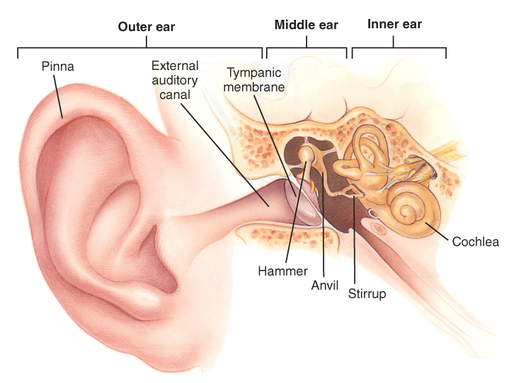
Injuries of the Ear (2 of 4)
FIGURE 28-29 The ear has three principal parts: the external, or outer, ear, composed of the pinna, external auditory canal, and tympanic membrane; the middle ear, including the hammer, anvil, and stirrup; and the inner ear, composed of bony chambers filled with fluid.
© Jones & Bartlett Learning.
Notes:
The figure on this slide shows the structure of the ear.

Slide 75
Injuries of the Ear (3 of 4)
Ears are often injured, but they do not usually bleed very much.
  In case of an ear avulsion, wrap the avulsed part in a moist, sterile dressing and put it in a plastic bag.
Tympanic membrane rupture
  Patients will report severe ear pain, difficulty hearing, or ringing in the affected ear.
Notes:
Lecture Outline
2. Ears are often injured, but they do not usually bleed very much.
a. If local pressure does not control bleeding, apply a roller dressing.
3. In case of an ear avulsion, wrap the avulsed part in a moist, sterile dressing and put it in a plastic bag labeled with the patient’s name.
4. Tympanic membrane rupture
a. Sudden changes in pressure created by a blast wave may cause rupture.
b. Patients will report severe pain, difficulty hearing, or ringing in the affected ear.

Slide 76
Injuries of the Ear (4 of 4)
Tympanic membrane rupture (cont’d)
  May be caused by insertion of objects too far into the ear.
Children place foreign bodies in the external auditory canal.
Clear fluid coming from the ear may indicate a skull fracture.
Notes:
Lecture Outline
c. May be caused by insertion of objects too far into the ear
5. Children place foreign bodies in the external auditory canal.
a. All foreign bodies should be removed by a physician.
b. Do not try to manipulate the foreign body; you may push it further into the ear.
6. Clear fluid coming from the ear may indicate a skull fracture.

Slide 77
Facial Fractures (1 of 2)
Typically result from blunt impact
Assume a direct blow to the mouth or nose has caused a facial fracture.
Other clues include:
  Bleeding in the mouth
  Inability to swallow or talk
  Absent or loose teeth
  Loose or movable bone fragments
Notes:
Lecture Outline
D. Facial fractures
1. Typically result from blunt impact
2. Assume that any patient who has sustained a direct blow to the mouth or nose has a facial fracture.
3. Signs and symptoms include bleeding in the mouth, inability to swallow or talk, absent or loose teeth, and/or movable bone fragments

Slide 78
Facial Fractures (2 of 2)
Facial fractures alone are not acute emergencies unless there is serious bleeding.
Plastic surgeons can repair the damage to the face and mouth if the injuries are treated within 7 to 10 days.
Swelling can be extreme within the first 24 hours after injury.
Notes:
Lecture Outline
4. Facial fractures alone are not acute emergencies unless there is serious bleeding.
a. In addition to external hemorrhage, there is the danger of blood clots lodging in the upper airway and causing an obstruction.
5. Plastic surgeons can repair the damage to the face and mouth if the injuries are treated within 7 to 10 days.
a. Remove and save loose teeth or bone fragments from the mouth because it is often possible to replant them.
b. Remove any loose dentures or dental bridges to protect against airway obstruction.
6. Another source of airway obstruction is swelling, which can be extreme within the first 24 hours after injury.

Slide 79
Dental Injuries (1 of 2)
Can be traumatic to the patient
Bleeding will occur whenever a tooth is violently displaced from its socket.
  Apply direct pressure to stop the bleeding.
  Perform suctioning if needed.
  Cracked or loose teeth are possible airway obstructions.
Notes:
Lecture Outline
E. Dental injuries
1. Can be traumatic to the patient.
a. The injury may be traumatic, and the patient’s permanent teeth may be lost.
2. Bleeding will occur whenever a tooth is violently displaced from its socket.
a. Apply direct pressure to stop the bleeding.
b. Perform suctioning if needed.
c. Cracked or loose teeth are possible airway obstructions.

Slide 80
Dental Injuries (2 of 2)
Save and transport an avulsed tooth.
  Handle it by the crown rather than the root.
  Place the tooth in tooth storage solution, cold milk, or sterile saline.
  Notify the hospital.
  Reimplantation is recommended within 20 minutes to 1 hour after the trauma.
Notes:
Lecture Outline
3. Management
a. Save and transport an avulsed tooth, handling it by the crown rather than by the root.
b. Place the tooth in tooth storage solution, cold milk, or sterile saline.

Slide 81
Injuries of the Cheek
You may encounter an object impaled in the patient’s cheek.
  If you are unable to control the bleeding, consider removing the object.
  Provide direct pressure on the inside and outside of the cheek.
  The amount of bandaging should not occlude the mouth.
Notes:
Lecture Outline
F. Injuries of the cheek
1. Impaled object
a. If you are unable to control the bleeding and it compromises the airway, consider removing the object.
b. Provide direct pressure both on the inside and outside of the cheek.
c. The amount of bandaging should not be so overwhelming that it occludes the mouth and makes it difficult to breathe.

Slide 82
Injuries of the Neck (1 of 4)
The neck contains many structures vulnerable to injury by blunt trauma.
  Upper airway
  Esophagus
  Carotid arteries and jugular veins
  Thyroid cartilage (Adam’s apple)
  Cricoid cartilage
  Upper part of the trachea
Notes:
Lecture Outline
G. Injuries of the neck
1. The neck contains many structures vulnerable to injury by blunt trauma, including:

Slide 83
Injuries of the Neck (2 of 4)
Blunt injuries
  Any crushing injury of the upper part of the neck is likely to involve the larynx or trachea.
  Can lead to loss of voice, difficulty swallowing, severe and sometimes fatal airway obstruction, and leakage of air into soft tissues of the neck
Notes:
Lecture Outline
2. Blunt injuries
a. Any crushing injury of the upper part of the neck is likely to involve the larynx or trachea.
b. Fractures of upper airway and laryngeal cartilage:
i. Signs and symptoms include loss of voice, difficulty swallowing, severe and sometimes fatal airway obstruction, and leakage of air into the soft tissues of the neck (subcutaneous emphysema).

Slide 84
Injuries of the Neck (3 of 4)
Blunt injuries (cont’d)
  Subcutaneous emphysema is a characteristic crackling sensation produced by the presence of air.
  Complete airway obstruction can develop rapidly.
  Consider ALS support early.
  Consider spinal motion restriction.
Notes:
Lecture Outline
c. Management
i. Maintain the airway and immediately transport.
ii. Consider ALS support early.
iii. Consider spinal motion restriction.

Slide 85
Injuries of the Neck (4 of 4)
Penetrating injuries
  Can cause profuse bleeding from laceration of the great vessels in the neck
  Injuries to the carotid and jugular veins can cause the body to bleed out (exsanguination).
  Injuries to these large vessels may also allow air to enter the circulatory system, which can lead to air embolism and cardiac arrest.
  Direct pressure will control most bleeding.
Notes:
Lecture Outline
3. Penetrating injuries
a. Can cause profuse bleeding from laceration of the great vessels in the neck.
b. Injuries to the carotid and jugular veins in the neck can cause the body to bleed out (exsanguination). If a vein has been punctured, an air embolism may result.
c. The airway, the esophagus, and the spinal cord can be damaged by a penetrating injury.
d. Direct pressure over the bleeding site will control most neck bleeding. Follow the steps in Skill Drill 28-3.
e. Assess for signs of shock, initiate spinal motion restriction if indicated, and apply high-flow oxygen.

Slide 86
Laryngeal Injuries (1 of 4)
Blunt force trauma to the larynx can occur when:
  Unrestrained driver strikes steering wheel.
  Snowmobile rider strikes a clothesline.
The larynx becomes crushed against the cervical spine, resulting in soft-tissue injury, fractures, and/or separation of the fascia.
Notes:
Lecture Outline
H. Laryngeal injuries
1. Blunt force trauma to the larynx can occur when:
a. Unrestrained driver strikes the steering wheel.
b. Snowmobile rider or off-road biker strikes a clothesline or a fixed wire.
2. The larynx becomes crushed against the cervical spine, resulting in soft-tissue injury, fractures, and/or separation of the fascia.
a. These strangulation injuries can also be found in either intentional or unintentional hangings.
b. Any time there is a suspected injury to the larynx, suspect possible cervical spine injury.

Slide 87
Laryngeal Injuries (2 of 4)
Penetrating or impaled objects in the larynx should not be removed unless they interfere with CPR.
  Stabilize all impaled objects if they are not obstructing the airway.
Notes:
Lecture Outline
3. Penetrating or impaled objects in the larynx should not be removed unless they interfere with cardiopulmonary resuscitation.
a. Stabilize all impaled objects if they are not obstructing the airway.

Slide 88
Laryngeal Injuries (3 of 4)
Signs and symptoms of larynx injuries:
  Respiratory distress
  Hoarseness
  Pain
  Difficulty swallowing (dysphagia)
  Cyanosis
  Pale skin
  Sputum in the wound
Notes:
Lecture Outline
4. Significant injuries to the larynx pose an immediate risk of airway compromise.
a. Signs and symptoms of larynx injuries include respiratory distress, hoarseness, pain, difficulty swallowing, cyanosis, pale skin, sputum in the wound, subcutaneous emphysema, bruising on the neck, hematoma, and bleeding

Slide 89
Laryngeal Injuries (4 of 4)
Signs and symptoms (cont’d)
  Subcutaneous emphysema
  Bruising on the neck
  Hematoma
  Bleeding
To manage a laryngeal injury:
  Provide oxygen and ventilation.
  Apply cervical immobilization but avoid rigid collars.
Notes:
Lecture Outline
a. Signs and symptoms of larynx injuries include respiratory distress, hoarseness, pain, difficulty swallowing, cyanosis, pale skin, sputum in the wound, subcutaneous emphysema, bruising on the neck, hematoma, and bleeding
b. Management:
i. Provide oxygen and ventilation.
ii. Apply cervical immobilization but avoid the use of rigid collars.

Slide 90
Review
Which of the following statements regarding the “Adam’s apple” is FALSE?
  It is inferior to the cricoid cartilage.
  It is formed by the thyroid cartilage.
  It is the uppermost part of the larynx.
  It is more prominent in men than in women.

Slide 91
Review
Answer: A
Rationale: The most obvious prominence in the center of the anterior neck is the Adam’s apple. This prominence is the upper part of the larynx, formed by the thyroid cartilage. It is more prominent in men than in women. The other portion of the larynx is the cricoid cartilage, a firm ridge that is inferior to the thyroid cartilage.

Slide 92
Review
Which of the following statements regarding the “Adam’s apple” is FALSE?
  It is inferior to the cricoid cartilage.
  Rationale: Correct answer.
  It is formed by the thyroid cartilage.
  Rationale: This is true.
  It is the uppermost part of the larynx.
  Rationale: This is true.
  It is more prominent in men than in women.
  Rationale: This is true.

Slide 93
Review
The globe of the eye is also called the:
  lens.
  orbit.
  retina.
  eyeball.

Slide 94
Review
Answer: D
Rationale: The globe of the eye is also called the eyeball. The lens, which sits behind the iris, focuses images on the retina—the light-sensitive area at the back of the globe. The globe is located within a bony socket in the skull called the orbit.

Slide 95
Review
The globe of the eye is also called the:
  lens.
  Rationale: The lens sits behind the iris and focuses images on the light-sensitive area at the back of the globe.
  orbit.
  Rationale: The orbit forms the base of the floor of the cranial cavity and contains the eye.
  retina.
  Rationale: The retina is the light-sensitive area at the back of the globe.
  eyeball.
  Rationale: Correct answer

Slide 96
Review
When a person is looking at an object up close, the pupils should:
  dilate.
  constrict.
  remain the same size.
  dilate, and then constrict.

Slide 97
Review
Answer: B
Rationale: The pupils, which allow light to move to the back of the eye, constrict in bright light and dilate in dim light. The pupils should also constrict when looking at an object up close and dilate when looking at an object farther away; this is called pupillary accommodation. These pupillary adjustments occur almost instantaneously.

Slide 98
Review
When a person is looking at an object up close, the pupils should:
  dilate.
  Rationale: The pupils will dilate when looking at objects far away.
  constrict.
  Rationale: Correct answer
  remain the same size.
  Rationale: The pupils will constrict when looking at objects that are close.
  dilate, and then constrict.
  Rationale: The pupils will constrict first when looking at close objects.

Slide 99
Review
When caring for a chemical burn to the eye, the EMT should:
  prevent contamination of the opposite eye.
  immediately cover the injured eye with a sterile dressing.
  avoid irrigating the eye, as this may cause further injury.
  irrigate both eyes simultaneously, even if only one eye is injured.

Slide 100
Review
Answer: A
Rationale: When irrigating a chemical burn to the eye, it is important to direct the stream away from the uninjured eye. If you do not, you will likely flush the chemical into the unaffected eye. After irrigating the eye for the appropriate amount of time, cover both eyes with a sterile dressing.

Slide 101
Review
When caring for a chemical burn to the eye, the EMT should:
  prevent contamination of the opposite eye.
  Rationale: Correct answer
  immediately cover the injured eye with a sterile dressing.
  Rationale: Irrigation of the eye must take place first.
  avoid irrigating the eye, as this may cause further injury.
  Rationale: Irrigation of the affected eye must take place. Direct the stream away from the uninjured eye.
  irrigate both eyes simultaneously, even if only one eye is injured.
  Rationale: Direct the stream of the contaminated eye away from the unaffected eye.

Slide 102
Review
Which of the following signs is LEAST indicative of a head injury?
  Asymmetric pupils
  Pupillary constriction to bright light
  Both eyes moving in opposite directions
  Inability to look upward when instructed to

Slide 103
Review
Answer: B
Rationale: The pupils normally constrict in bright light and dilate in dim light. Suspect a head injury if the pupils do not react appropriately, are asymmetric (unequal), do not move together, or if the patient is unable to look upward.

Slide 104
Review
Which of the following signs is LEAST indicative of a head injury?
  Asymmetric pupils
  Rationale: This may be an indication of a head injury.
  Pupillary constriction to bright light
  Rationale: Correct answer
  Both eyes moving in opposite directions
  Rationale: This may be an indication of a head injury.
  Inability to look upward when instructed to
  Rationale: This may be an indication of a head injury.

Slide 105
Review
The purpose of the eustachian tube is to:
  move in response to sound waves.
  transmit impulses from the brain to the ear.
  equalize pressure in the middle ear when external pressure changes.
  house fluid within the inner chamber of the ear and support balance.

Slide 106
Review
Answer: C
Rationale: The middle ear is connected to the nasal cavity by the eustachian tube, which permits equalization of pressure in the middle ear when external atmospheric pressure changes.

Slide 107
Review
The purpose of the eustachian tube is to:
  move in response to sound waves.
  Rationale: This occurs in the tympanic membrane or eardrum.
  transmit impulses from the brain to the ear.
  Rationale: Impulses are transmitted from the ear to the brain.
  equalize pressure in the middle ear when external pressure changes.
  Rationale: Correct answer
  house fluid within the inner chamber of the ear and support balance.
  Rationale: Bony chambers in the inner ear support balance.

Slide 108
Review
When caring for a patient with facial trauma, the EMT should be MOST concerned with:
  spinal trauma.
  airway compromise.
  associated eye injuries.
  severe external bleeding.

Slide 109
Review
Answer: B
Rationale: No airway, no patient! Injuries to the face often cause obstruction of the upper airway, either by clotted blood or associated swelling. Additionally, large amounts of blood can be swallowed, which increases the risks of vomiting and aspiration. Bleeding control, spinal trauma, and associated injuries are important factors and should be treated accordingly; however, the airway comes first.

Slide 110
Review
When caring for a patient with facial trauma, the EMT should be MOST concerned with:
  spinal trauma.
  Rationale: This is a concern to be treated, but treating the airway is first.
  airway compromise.
  Rationale: Correct answer
  associated eye injuries.
  Rationale: This is a concern to be treated, but treating the airway is first.
  severe external bleeding.
  Rationale: This is a concern to be treated, but treating the airway is first.

Slide 111
Review
The presence of subcutaneous emphysema following trauma to the face and throat is MOST suggestive of:
  esophageal injury.
  cervical spine fracture.
  crushing tracheal injury.
  carotid artery laceration.

Slide 112
Review
Answer: C
Rationale: Crushing injuries or fractures of the larynx or trachea can result in a leakage of air into the soft tissues of the neck. The presence of air in the soft tissues produces a characteristic crackling sensation called subcutaneous emphysema.

Slide 113
Review
The presence of subcutaneous emphysema following trauma to the face and throat is MOST suggestive of:
  esophageal injury.
  Rationale: This will produce bleeding, which may be observed in the patient’s mouth or through difficulty swallowing.
  cervical spine fracture.
  Rationale: This may be indicated by pain and/or paralysis.
  crushing tracheal injury.
  Rationale: Correct answer
  carotid artery laceration.
  Rationale: This could be assessed by excessive swelling or the presence of a large hematoma in the neck area.

Slide 114
Review
A 21-year-old male has a large laceration to his neck. When you assess him, you note that bright red blood is spurting from the left side of his neck. You should immediately:
  apply a pressure dressing to his neck.
  sit the patient up to slow the bleeding.
  place your gloved hand over the wound.
  apply 100% oxygen via nonrebreathing mask.

Slide 115
Review
Answer: C
Rationale: Laceration of the carotid artery—as evidenced by bright red blood spurting from the wound—can cause profuse bleeding, profound shock, and death very quickly. You must immediately control the bleeding with the use of direct pressure. Cover the wound with your gloved hand initially and then apply a bulky pressure dressing. After the bleeding has been controlled, apply high-flow oxygen and transport promptly.

Slide 116
Review
A 21-year-old male has a large laceration to his neck. When you assess him, you note that bright red blood is spurting from the left side of his neck. You should immediately:
  apply a pressure dressing to his neck.
  Rationale: You should apply a bulky dressing to control bleeding.
  sit the patient up to slow the bleeding.
  Rationale: Bleeding must be controlled first with direct pressure.
  place your gloved hand over the wound.
  Rationale: Correct answer
  apply 100% oxygen via nonrebreathing mask.
  Rationale: A nonrebreathing mask is applied after bleeding is controlled.

Slide 117
Review
Which of the following mechanisms of injury would MOST likely cause a crushing injury of the larynx and/or trachea?
  Attempted suicide by hanging
  Gunshot wound to the lateral neck
  Car crash involving lateral impact
  Patient whose head hits the windshield

Slide 118
Review
Answer: A
Rationale: Any crushing injury of the upper part of the neck is likely to involve the larynx or trachea. Examples include the anterior neck impacting a steering wheel, hanging (distraction) mechanisms, and clothesline injuries.

Slide 119
Review
Which of the following mechanisms of injury would MOST likely cause a crushing injury of the larynx and/or trachea?
  Attempted suicide by hanging
  Rationale: Correct answer
  Gunshot wound to the lateral neck
  Rationale: This would produce a penetrating injury.
  Car crash involving lateral impact
  Rationale: This would produce an injury to the spine and possibly the head.
  Patient whose head hits the windshield
  Rationale: This would produce an injury to the head or a compression injury to the spine.

